Slide 1
photo booth for rental in Culver City
https://www.luckyfrogphotos.com/culvercityphotobooth.html
Notes:
https://www.luckyfrogphotos.com/culvercityphotobooth.html
https://drive.google.com/drive/folders/1dt-pGMlwGIKNZKY8-pQXklpb52o4xFcZ?usp=sharing
https://news.google.com/rss/search?q=videobooth
https://drive.google.com/drive/folders/1hEB_nod9_b9WcigGoY3Ik-UmGPkXzQTb?usp=sharing
https://drive.google.com/drive/folders/1JkVf11-k_XzcCU_3bSIC_1DWiIOxX89P?usp=sharing
https://drive.google.com/drive/folders/1yP8fFeyS4ZoJOTt42_XIJNKTNCIxJlps?usp=sharing
https://drive.google.com/drive/folders/1PLdyRU2PFWYfrqP7M-5X2iixb1KsdfyE?usp=sharing
https://drive.google.com/file/d/1t33hvFbsi4sSFSNdR8g74m5ACVKQUi0g/view?usp=sharing
https://drive.google.com/file/d/1_qwZ-L3xe5NV0PL-BqQhf-sKuAu2kxT9/view?usp=sharing
https://docs.google.com/spreadsheets/d/1uZEdB9UO2JI9fENQx4bHuXWK4ZCd0N8pURqpCYZEF94/edit?usp=sharing
https://docs.google.com/spreadsheet/pub?key=1uZEdB9UO2JI9fENQx4bHuXWK4ZCd0N8pURqpCYZEF94
https://docs.google.com/spreadsheets/d/1uZEdB9UO2JI9fENQx4bHuXWK4ZCd0N8pURqpCYZEF94/pubhtml
https://docs.google.com/spreadsheets/d/1uZEdB9UO2JI9fENQx4bHuXWK4ZCd0N8pURqpCYZEF94/pub
https://docs.google.com/spreadsheets/d/1uZEdB9UO2JI9fENQx4bHuXWK4ZCd0N8pURqpCYZEF94/view
https://docs.google.com/forms/d/1dPeOveelrBYxA8GzW2fOEWvr7EcJaBWweQr9vVo2fRQ/edit?usp=sharing
https://docs.google.com/drawings/d/11lnnHT29h6QpBn96lLxQTfNDzVm2kiQV9_xRDs89HM4/edit?usp=sharing
https://drive.google.com/file/d/1Ub_baxN1yIKa7z6PHbWKiQ5Hv3QmkYdb/view?usp=drivesdk
https://sites.google.com/view/culvercityphotoboothrentals/home
https://docs.google.com/document/d/18X_aBHdfg2-imz0uQvFOq561Fxx4n-5xp3gdHQvL8jk/edit?usp=sharing
https://docs.google.com/document/d/18X_aBHdfg2-imz0uQvFOq561Fxx4n-5xp3gdHQvL8jk/pub
https://docs.google.com/document/d/18X_aBHdfg2-imz0uQvFOq561Fxx4n-5xp3gdHQvL8jk/view
https://docs.google.com/presentation/d/1LiVt-tNBBXK3MB-3PqrwcpCeSmNgf0CX87PcPtYBx6I/edit?usp=sharing
https://docs.google.com/presentation/d/1LiVt-tNBBXK3MB-3PqrwcpCeSmNgf0CX87PcPtYBx6I/pub?start=true&loop=true&delayms=3000
https://docs.google.com/presentation/d/1LiVt-tNBBXK3MB-3PqrwcpCeSmNgf0CX87PcPtYBx6I/view
https://docs.google.com/presentation/d/1LiVt-tNBBXK3MB-3PqrwcpCeSmNgf0CX87PcPtYBx6I/htmlpresent

Slide 2
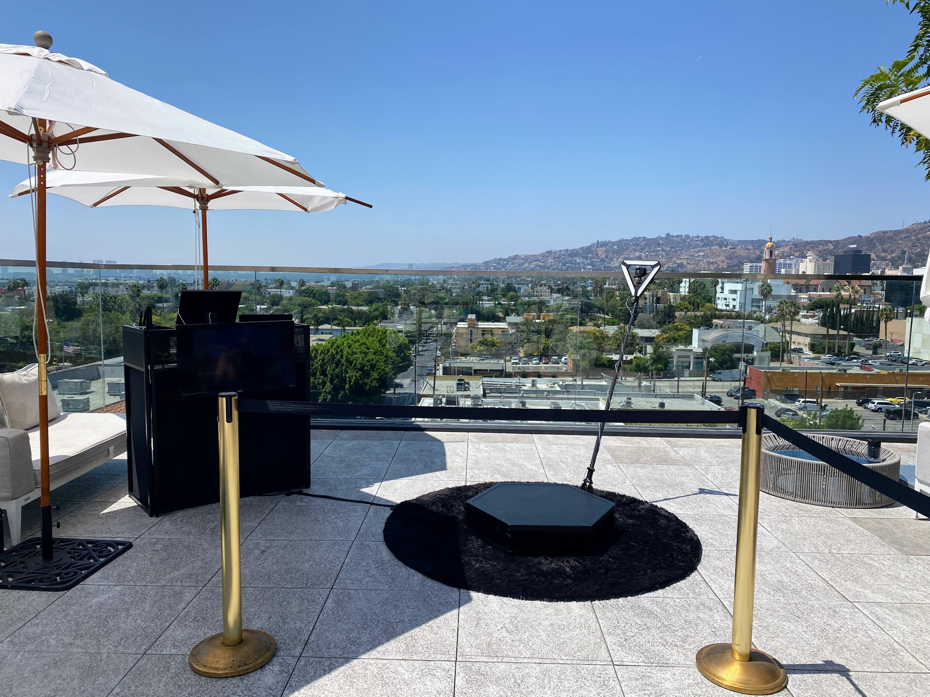

Slide 4
photo booth for rental in Culver City
Just afterward Dining out, not all 360 video booth rentals near San Gabriel are similar. in imitation of our best air photo booth services, we hand crafted the best character spinner platform and slow pastime video gear to create determined your slomo Videos are the best in al of San Gabriel and the 626 area. Our get into freshen Photo Booths, Selfie Stations, Video booths and 360 Photo Booths are essentially one of a kind, and are crafted using lonely the best materials on the order of Los Angeles. Unlike the humiliate atmosphere made in China booths that are a dime a dozen, our unique booths are handcrafted, professionally made and will look astounding at your bordering situation on the order of San Gabriel. Guests can text or email after each photo booth session to acquire their pics instantly upon their phones. Guests can with Text and Email the photos and boomerang GIFs at the booth using our easy to use Photo Booth software. We lonely use the best setting multimedia equipment that offers the best for activities in Los Angeles and meet the expense of High-end bearing in mind social media integration and {} we are a photo entertainment company that specializes in studio lighting techniques. Our photo booth Pictures are the highest quality in Los Angeles and all of yellow County, are in focus and distinct taking into account proper studio lighting. We afterward meet the expense of the very best in unique or custom options to customize the print designs using your brand, logo and theme. We have a big selection of backdrops that are some of the finest available, and will meet the expense of a good and fun showing off to entertain for any occasion Our 360 booths are a good ice breaker for guests here in the San Gabriel Valley, and we have a bunch of every second looks to match your 626 event. Also, the customer facilitate experience we have the funds for guaranteed to make your corporate event, wedding or additional occasion unforgettable, and to save the photo booth fun for you and your guests. Lastly, even if creating lasting memories, we will make certain youll get lab-quality photos from the read air photo booth. You have a big number of possibilities for your neighboring photo booth rentals here in San Gabriel, and is a absolute fit for any issue type. Our Photo booths create a customized experience for any event,and Best Photo Booths Fun For all Ages and we honor Winning benefits that is unmatched. The character of the photo kiosk is super important; after all, you dont want an unprofessional-looking photo booth at your next event! We struggle to come up with the money for our customers a extraordinary photo experience and we are Southern California's premier special business photo booth company, lucky Frog Photo Booth is the Los Angeles and yellow County area's premier photo booth rental company that is tailor-made for captivation and photo entertainment. Each business has its lasting memories, and we will create positive all gets custom tailored to your business needs. Our 360 Photo Booth is extremely unique and handcrafted in the USA, and will accumulate upon a unique supplement to just more or less any event: We will be happy to walk you through the booking process, we will go as far away as humanly doable to create your thing happen.
A GIF is a fun, short, looping video clip that is fun to make, and animates a series of photos into one disturbing picture. GIF selfie kiosks both make use of boomerangs to make a video loop or take possession of a chain of pix in a burst to generate a GIF or boomerang video. {} {} Photo kiosks will permit more associations when your celebration visitors and create a sharable video that everybody can enjoy instantly. Slow-mo changes whatever in the video, therefore even a small movement can look super cool. similar to many additional technologies, a slo mo video was back reserved abandoned for film studios, however it has now made its quirk to a photo booth rental. {} {} Relive captured thing videos together along taking into consideration your links or name the videos online for every your associates to enjoy.Choose the maximum okay place upon your video booth setup; usually on the order of 15 ft x 15 ft works great. {} Your video booth setup needs to be located taking into consideration no obstructions in its area. Our 360 photo booth rental is more than just a enjoyable admittance freshen photo booth; It will find the money for a unique video experience and permit you to take control of your event in a gather together supplementary way. {} Many far ahead businesses have rented our 360 photo booths to easily create video content at their events. {} {} {}&nbsp;Regardless of the issue type, the 360 video booth gives a one-of-a-kind experience for any event; Thanksgiving Parties, Office get-togethers, Corporate Functions, intimates Christmas parties, Company Parties, Holiday Events, Santa Celebrations, Hanukkah Parties just to publish a few. {} Your aspiration should be to have the funds for event guests an experience they can easily ration and renting a 360 photo booth facilitate is one of the most fun ways for you to level taking place any event. In the age of Tiktock and stories, video content is taking beyond social media, when lots more concentration coming from a video make known vs photos. in imitation of many ocher County situation planners these days, you may be wondering how to seize a quick video at your concern for attendees to allocation instantly. After appear in some research, you may have realized that hiring a professional video team is too expensive and the production times takes weeks if not months to produce feel video content. Using big video lights, production equipment, and the production team that runs them can be totally intimidating to the participants who are not used to mammal in tummy of a professional camera. Our Viral Video Photo Booth is the ideal answer for orange County business planners who compulsion to make engaging user-generated videos for social media and build them in genuine time. Social Media is all just about act out things fast, and lets point it, not everyone is a wiz at creating branded videos when their phones. Our Viral Video Photo Booth is the ideal method that provides a convenient pretentiousness to instantly take possession of buzz-worthy video clips at event events, weddings, and parties. Videos are currently the top-ranking content on social media platforms because they save people engaged longer than supplementary types of content such as photos of food or their pets. People adore to watch videos upon their phones on social media platforms such as TikTok, Instagram Reels, YouTube shorts, and Facebook Stories just to make known a few. As a result, social media algorithms are much more likely to rank your videos toward the top, giving you more opportunities to push your brand or occupy a larger audience. {} A video photo booth will divert your guest in the same way as tone party entertainment and present them the opportunity to share spacious other content behind your company branding. {} Our viral video photo booth allows you to engage considering your guests in a amass extra pretension by capturing videos using fun and interactive kiosks at your situation rather than a large video production crew. Our viral video photo booth provides a unique video experience that can be set stirring at stand-in types of comings and goings including your next: Birthday Party, Brand Activation, OC Corporate Event, ocher County Red carpet Gala, Wedding, Baby Shower, Wedding Anniversary, immersion Party or OC Bridal Shower.
https://www.luckyfrogphotos.com/culvercityphotobooth.html
Notes:
photo booth for rental in Culver City

Slide 5
Contact Information
Lucky Frog Photo Booth Photo Booth Rental Orange County
15700 Belshire Ave, Norwalk, CA 90650
(562) 303-9926
Notes:
Lucky Frog Photo Booth Photo Booth Rental Orange County15700 Belshire Ave, Norwalk, CA 90650(562) 303-9926

Slide 6
More info about us:
photo booth for rental in Culver City
Notes:
Lucky Frog Photo Booth Photo Booth Rental Orange County15700 Belshire Ave, Norwalk, CA 90650(562) 303-9926

Slide 7
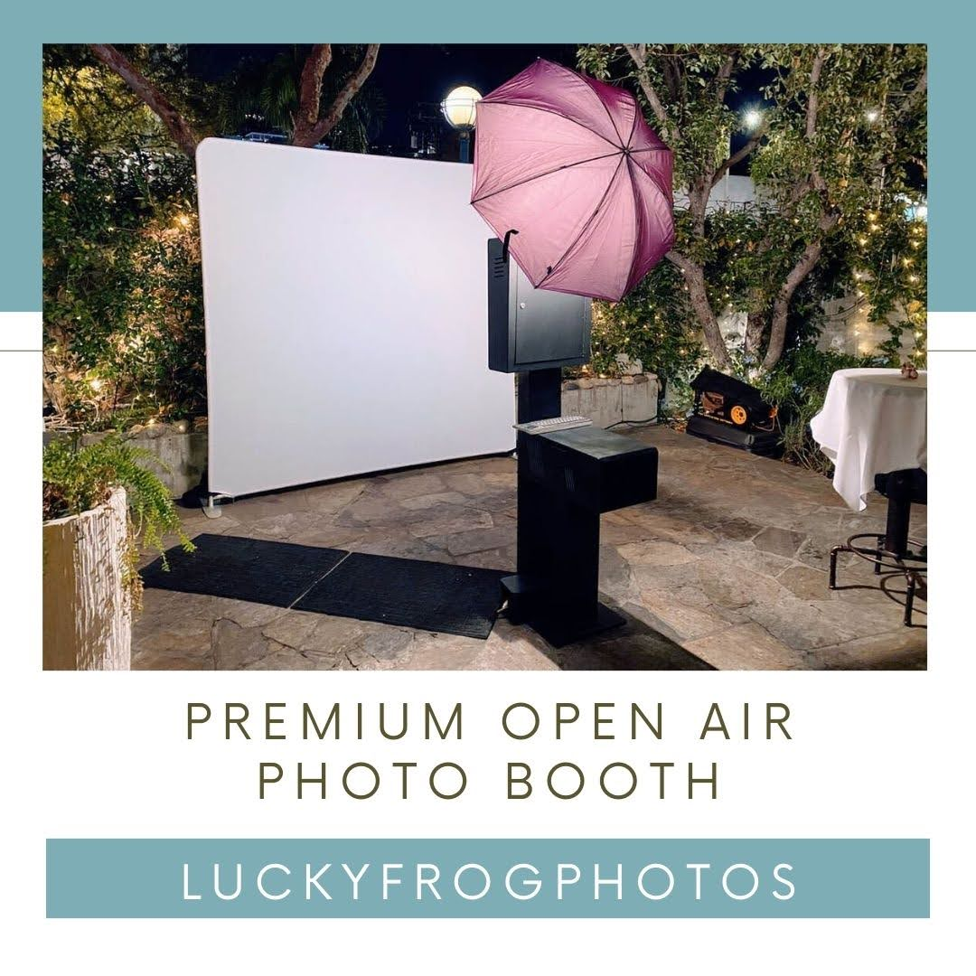

Slide 8
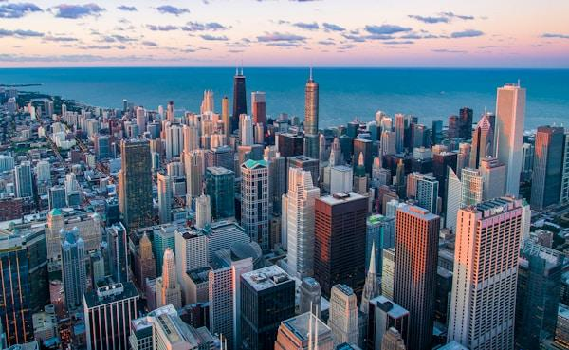

Slide 9
Links
List of recommended resources
Notes:
photo booth for rental in Culver City

Slide 10
Please visit :
target url
folder top
rss feed
folder articles
folder photos
folder pdfs
folder slides
photo
photo
spreadsheet
spreadsheet key
spreadsheet pubhtml
spreadsheet pub
spreadsheet view
form
drawing
image
image link
document
document pub
document view
presentation
presentation pub
presentation view
presentation html

Slide 11
Videos
YouTube videos we recommend watching!
Notes:
photo booth for rental in Culver City

Slide 12
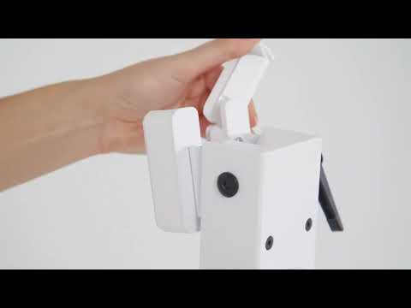
https://www.luckyfrogphotos.com/culvercityphotobooth.html

Slide 13
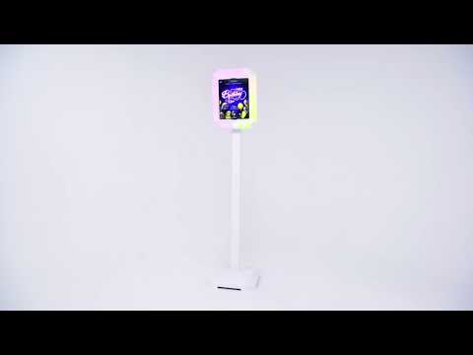
https://www.luckyfrogphotos.com/culvercityphotobooth.html

Slide 14
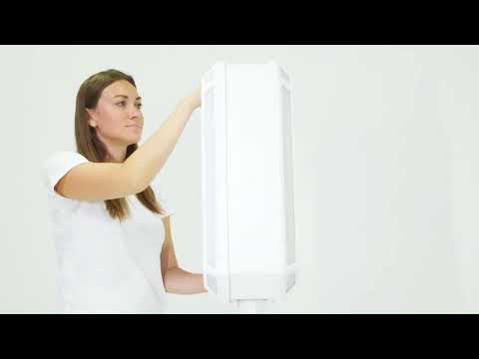
https://www.luckyfrogphotos.com/culvercityphotobooth.html

Slide 15
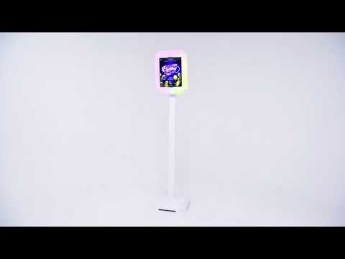
https://www.luckyfrogphotos.com/culvercityphotobooth.html

Slide 16
https://www.luckyfrogphotos.com/culvercityphotobooth.html
Notes:
https://www.luckyfrogphotos.com/culvercityphotobooth.html
https://drive.google.com/drive/folders/1dt-pGMlwGIKNZKY8-pQXklpb52o4xFcZ?usp=sharing
https://news.google.com/rss/search?q=videobooth
https://drive.google.com/drive/folders/1hEB_nod9_b9WcigGoY3Ik-UmGPkXzQTb?usp=sharing
https://drive.google.com/drive/folders/1JkVf11-k_XzcCU_3bSIC_1DWiIOxX89P?usp=sharing
https://drive.google.com/drive/folders/1yP8fFeyS4ZoJOTt42_XIJNKTNCIxJlps?usp=sharing
https://drive.google.com/drive/folders/1PLdyRU2PFWYfrqP7M-5X2iixb1KsdfyE?usp=sharing
https://drive.google.com/file/d/1t33hvFbsi4sSFSNdR8g74m5ACVKQUi0g/view?usp=sharing
https://drive.google.com/file/d/1_qwZ-L3xe5NV0PL-BqQhf-sKuAu2kxT9/view?usp=sharing
https://docs.google.com/spreadsheets/d/1uZEdB9UO2JI9fENQx4bHuXWK4ZCd0N8pURqpCYZEF94/edit?usp=sharing
https://docs.google.com/spreadsheet/pub?key=1uZEdB9UO2JI9fENQx4bHuXWK4ZCd0N8pURqpCYZEF94
https://docs.google.com/spreadsheets/d/1uZEdB9UO2JI9fENQx4bHuXWK4ZCd0N8pURqpCYZEF94/pubhtml
https://docs.google.com/spreadsheets/d/1uZEdB9UO2JI9fENQx4bHuXWK4ZCd0N8pURqpCYZEF94/pub
https://docs.google.com/spreadsheets/d/1uZEdB9UO2JI9fENQx4bHuXWK4ZCd0N8pURqpCYZEF94/view
https://docs.google.com/forms/d/1dPeOveelrBYxA8GzW2fOEWvr7EcJaBWweQr9vVo2fRQ/edit?usp=sharing
https://docs.google.com/drawings/d/11lnnHT29h6QpBn96lLxQTfNDzVm2kiQV9_xRDs89HM4/edit?usp=sharing
https://drive.google.com/file/d/1Ub_baxN1yIKa7z6PHbWKiQ5Hv3QmkYdb/view?usp=drivesdk
https://sites.google.com/view/culvercityphotoboothrentals/home
https://docs.google.com/document/d/18X_aBHdfg2-imz0uQvFOq561Fxx4n-5xp3gdHQvL8jk/edit?usp=sharing
https://docs.google.com/document/d/18X_aBHdfg2-imz0uQvFOq561Fxx4n-5xp3gdHQvL8jk/pub
https://docs.google.com/document/d/18X_aBHdfg2-imz0uQvFOq561Fxx4n-5xp3gdHQvL8jk/view
https://docs.google.com/presentation/d/1LiVt-tNBBXK3MB-3PqrwcpCeSmNgf0CX87PcPtYBx6I/edit?usp=sharing
https://docs.google.com/presentation/d/1LiVt-tNBBXK3MB-3PqrwcpCeSmNgf0CX87PcPtYBx6I/pub?start=true&loop=true&delayms=3000
https://docs.google.com/presentation/d/1LiVt-tNBBXK3MB-3PqrwcpCeSmNgf0CX87PcPtYBx6I/view
https://docs.google.com/presentation/d/1LiVt-tNBBXK3MB-3PqrwcpCeSmNgf0CX87PcPtYBx6I/htmlpresent

Slide 17
photo booth for rental in Culver City
https://www.luckyfrogphotos.com/culvercityphotobooth.html
Notes:
photo booth for rental in Culver City

